Slide 1

Chronic kidney disease prediction using machine learning
Presented By
122003073 - Gandrothu Pavan Sai Kishore (CSE)
122003138 - Maddu Bhaskar Vamsi Krishna (CSE) Guided by
122014053 - Tamalampudi Venkata Rama Reddy (ICT) Renugadevi T
Base Paper:
Pankaj Chittora ,Sandeep Chaurasia ,Prasun Chakrabarti and others, (2021) “Prediction of Chronic Kidney Disease - A Machine Learning Perspective”, IEEE Access.2021.3053763
Notes:
NOTE:
To change the image on this slide, select the picture and delete it. Then click the Pictures icon in the placeholder to insert your own image.

Slide 2

SCREENSHOT OF INDEXING

Slide 3
ABSTRACT
Since curing a disease is possible only after detection, disease detection has become an essential factor in the medical sector.
Chronic kidney disease (CKD), one among the major diseases that needs to be detected at early stages.
Nowadays, machine learning (ML) is playing a crucial role in the detection of diseases.
So, in this paper, we mainly focus on finding the best ML model for prediction of CKD. For this perspective, a dataset was collected from UCI repository.
We applied 7 ML classifier algorithms, namely, K-Nearest Neighbor (KNN), Logistic Regression (LR), Linear Support Vector Machine (LSVM) with penalties L1 and L2, Random Forest (RF), CHAID, C 4.5, and Artificial Neural Network (ANN) for prediction.
We apply Feature Selection (FS) methods such as full feature selection, correlation-based Feature Selection (CFS), wrapper FS, LASSO FS for selecting the features.
SMOTE, a data balancing technique is applied to the dataset for balancing the target class. Classifier performance is measured using accuracy, precision, recall, error, F-measure, AUC, and GINI index.

Slide 4
INTRODUCTION
What is CKD ?
Chronic kidney Disease (CKD) means your kidneys are damaged and not filtering your blood the way it should.
The primary role of kidneys is to filter extra water and waste from your blood to produce urine and if the person has suffered from CKD, it means that wastes are collected in the body.
This disease is chronic because of the damage gradually over a long period. It is flattering a common disease worldwide
Due to CKD may have some health troubles.
There are many causes for CKD like diabetes, high blood pressure, heart disease.
Along with these critical diseases, CKD also depends on age and gender

Slide 5
PROBLEM STATEMENT
CKD cannot be detected easily until the kidney is damaged badly. In this high-risk population, we are not able to check our status of the disease regularly.
By existing methods, we cannot predict the disease in advance. Using ML classifier algorithms, we can predict the disease on time.
OBJECTIVE
To build a high accurate machine learning model to predict whether the person have chronic kidney disease or not.

Slide 6
LITERATURE SURVEY
Publication /Year | Title | Overview | Positive Aspects | Limitations
RESEARCH GATE /2016 | Applying machine learning techniques for predicting the risk of chronic kidney disease | They applied Naïve Bayes and Decision tree techniques for the selected features, they were able to achieve the result of identification of Kidney disorder at the early stages. | The performance of Decision tree method was found to be 91% accurate compared to naive Bayes method. Classification algorithm on diabetes dataset performance was obtained as94% Specificity and 95% Sensitivity. | The performance of prediction system accuracy in neural network could be increased.
IEEE/2017 | Performance Evaluation on Machine Learning Classification Techniques for Disease Classification and Forecasting through Data Analytics for Chronic Kidney Disease (CKD) | Classification models have been built with different classification algorithms will predict the CKD and non CKD status of the patient. These models have applied on recently collected CKD dataset downloaded from the UCI repository with 400 data records and 25 attributes. | It is observed that the Multiclass Decision Forest algorithm provides the highest accuracy of 98.1%. | The data set taken was limited, by training the model with larger data set would increase the accuracy.

Slide 7
Publication /Year | Title | Overview | Positive Aspects | Limitations
IEEE/2018 | ‘‘Analysis of chronic kidney disease dataset by applying machine learning methods | The effects of using clinical features to classify patients with chronic kidney disease by using SVM algorithm is investigated. The chronic kidney disease dataset is based on clinical history, physical examinations, and laboratory tests. | The implemented classifier can reach the overall performance of 94.602%. The sensitivity value of SVM classifier with a linear kernel is 93.100%. | More compact and autonomous tools can be developed that could be used as a screening and also diagnosing mechanism as compare to other mentioned medical methods.
IEEE/2019 | ‘‘Explainable prediction of chronic renal disease in the colombian population using neural networks and case-based reasoning” | The model is trained with the demographic data and medical care information of two population groups: on the one hand, people diagnosed with CKD in Colombia during 2018. | The model is trained and evaluation metrics for classification algorithms are applied, the model achieves 95% accuracy in the test data set, making its application for disease prognosis feasible. | In this work, they have binarized the features to compare the most similar explanatory cases to the given patient description.

Slide 8
Publication/Year | Title | Overview | Positive Aspects | Limitations
IJACSA/2019 | ‘Detection of chronic kidney disease using machine learning algorithms with least number of predictors’ | Logistic regression, support vector machines, random forest, and gradient boosting algorithms have been trained and tested using 10-fold cross-validation. | Higher performance was achieved with the gradient boosting algorithm by F1-measure (99.1 %), sensitivity (98.8%), and specificity (99.3%). | The data set taken was not sufficient. More attributes can be considered.
IEEE/2020 | A machine learning methodology for diagnosing chronic kidney disease | The CKD data set was obtained from the University of California Irvine (UCI) . Algorithm used (LR ,RF, SVM, KNN, Naive Bayes classifier and feed forward neural network) . | They proposed an integrated model that combines logistic regression and random forest by using perceptron, which could achieve an average accuracy of 97.83% after ten times of simulation. | The data set used in this research was limited, so the accuracy of model may be improved by training with other large data set.

Slide 9
Publication/ Year | Title | Overview | Positive aspects | Limitations
IRJET/2020 | “Analysis and prediction of chronic kidney disease” | They implemented four ML Techniques, which includes Logistic Regression, Random Forest Tree, K-Nearest Neighbor, Neural Network . They conducted a systematic study of the outcomes of all three classifiers to figure out the correct classifier for CKD diagnosis. | They brought new variables that classifiers will use to classify CKD more accurately than state-of-the-art formulas. | The collection of data has certain noisy values which are missing.
HAL/2020 | Kidney failure detection using machine learning techniques. | They developed a system to detect kidney failure early and thus increase the chances of treatment for these patients. For this, several Machine Learning techniques(DT, SVM and RF) were used. | From the results obtained , they observed that the algorithm has a good ability to classify both renal and normal patients. They were able to achieve the DT stands out because it has the lowest values of PF and FN. | The prediction accuracy was low and could be further improved.

Slide 10
DATA SET & PREPROCESSING
DATA SET COLLECTION:
The CKD dataset for this paper was collected from the UCI website, which UC Irvine Machine Learning Repository was providing.
This dataset consists of 25 attributes and 400 instances. Of those 25 attributes, 24 are feature attributes and 1 is a target attribute.
The target attribute has 2 values: CKD or Not CKD
DATA CLEANING AND PREPROCESSING:
1) KNN IMPUTATION
Identification of missing values and replacing them is the first and foremost thing we have to do to the dataset. This is known as data cleaning.
One of the best approaches for data cleaning is to predict the missing values using an ML model. In this paper, we use the KNN algorithm for predicting missing values.

Slide 11
2) LABEL ENCODER
Label Encoding can be defined as the conversion of all the labels into numeric form, which will be further converted into a machine-readable form.
It is one of the best approaches for data preprocessing. In this paper, we convert all the labels into either int or float types.
3) TRAIN – TEST SPLIT
Train-Test Split is the most frequently used approach for preprocessing. In this process, the data is divided into two parts, one for training the model and the other for testing.
It is mainly used for estimating the performance of ML classifiers. In this paper, we consider the train-test split ratio to be 50:50.

Slide 12
METHODOLOGIES
FEATURE SELECTION METHODS
1) FULL FEATURE SELECTION :
In this case, we will consider all features as input for ML classifiers for prediction.
2) CORRELATION-BASED FEATURE SELECTION (CFS) :
CFS is one of the filter methods to select the features based on the correlation between them.
In this process, it will eliminate the highly correlated feature with the other feature.
It selects only the remaining features after eliminating the highly correlated ones.

Slide 13
3) WRAPPER METHOD :
In Wrapper FS, the feature selection takes place based on a precise ML classifier.
It uses a greedy approach for making subsets. Subsets can be formed either by the forward selection method or the backward elimination method.
In this paper, we use "forward selection." In forward selection, the subset is initially null and, iteratively, the features are added.
4) LASSO METHOD:
LASSO (least absolute shrinkage and selection operator) FS is an embedded method of FS.
In the embedded method, features are selected based on decision trees.
In LASSO method, two processes take place: regularization and feature selection.
In regularization, the coefficients of unimportant features are shrunk to zero, and in feature selection, the features with zero coefficients are eliminated.

Slide 14
ML CLASSIFIER ALGORITHMS:
1) LOGISTIC REGRESSION (LR) :
Logistic regression is one of supervised ML classifiers. It's a mathematical model. It predicts the probability of achieving the target value.
It categorizes the target attribute as either successful or unsuccessful. It returns 1 when successful, and 0 when unsuccessful.
2) K- NEAREST NEIGHBORS (KNN) :
KNN is a simplest supervised algorithm. For both classification and regression problems KNN is applicable.
It is, however, primarily used for solving classification problems.
The distance between two already labelled data sets is calculated. The distance aids in locating the new data nearest neighbor. Distance is calculated using the Euclidian method.

Slide 15
3) LINEAR SUPPORT VECTOR MACHINE (LSVM) :
LSVM is a latest, uniquely fast machine learning algorithm that uses a simple iterative approach to solve multiclass classification problems for large datasets.
The SVM model is built in the dataset's linear CPU time. There are two penalty cases, L1 and L2.
4) CHAID :
This decision tree technique is chi-square automatic interaction detection (CHAID). It's used to figure out how variables are related to one another.
CHAID can find the outcome using nominal, ordinal, and continuous data.
5) C 4.5 :
C4.5 is a decision tree in the sense that from input it generates the decision tree. The tree will have the specified count of branches.
The structure of tree is used to find out the relationship between potential outcomes and features. This process is iterative and continues until no further splits are found.

Slide 16
6) ARTIFICIAL NUERAL NETWORK (ANN) :
ANN is a type of AI. It falls under the category of supervised ML. It has the same structure as the human brain.
It can solve problems that human or statistical standards have failed to solve.
7) RANDOM FOREST (RF) :
Random forests, also called as random decision forests, is an ensemble learning classifier for regression and classification that works by constructing a big number of decision trees during training.
For classification tasks, the random forest output is the class chosen by the majority of trees. The mean prediction value of the different trees is returned for regression tasks.
RF outperform decision trees in general.

Slide 17
SMOTE:
Data balancing is the major problem one is facing while using dataset for prediction.
There are 2 methods for data balancing, oversampling and under sampling.
In this case we use oversampling. For oversampling the minority class, the SMOTE is used.
It is also referred to as a data balancer.
It accepts the entire dataset as input but works only on the minority class.
It raises the proportion of minorities in the population.
This methodology expands the features available for target class.

Slide 18
WORK FLOW ML Algorithms
ANN
Feature Selection
C 4.5
Correlation Based
Logistic Regression
Best Performed algorithms in best feature selection techniques are selected.
CKD data-set
Data preprocessing
Wrapper
Selected Features
CHAID
Performance Evaluation Measures
LSVM penalty L1
LASSO
LSVM penalty L2
Full Features
kNN
Random Forest

Slide 19
Work Flow With SMOTE:
ML Algorithms
Logistic Regression
Feature Selection
LSVM: Penality L1
Full Features
Target Class instances are converted to Binary
Best Performed Algorthim is used for Prediction
Pre-Processed data-set
SMOTE
Performance Evaluation Measures
selected Features
LSVM: Penality L2
CHAID
LASSO Feature Selection
C 4.5
CKD
Not CKD
Random Forest

Slide 20
PERFORMANCE EVALUATION MEASURES:
Confusion Matrix Description
Classification Accuracy
Classification Error
Precision
Recall
F-Measure
AUC – Area Under the Curve
Gini Index

Slide 21
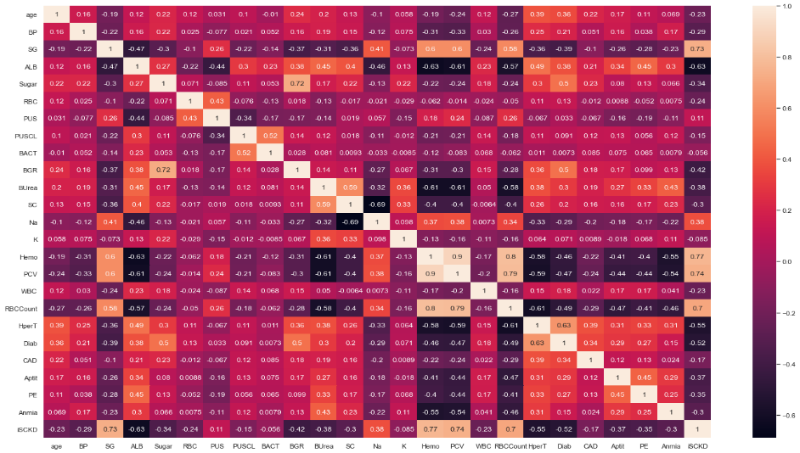
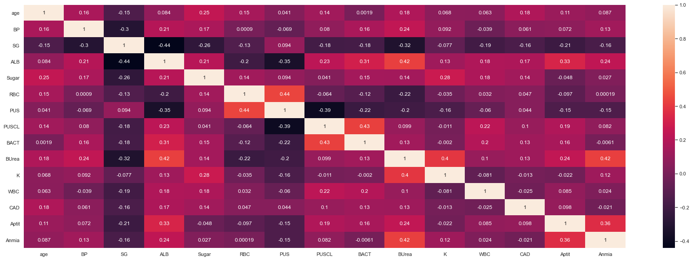
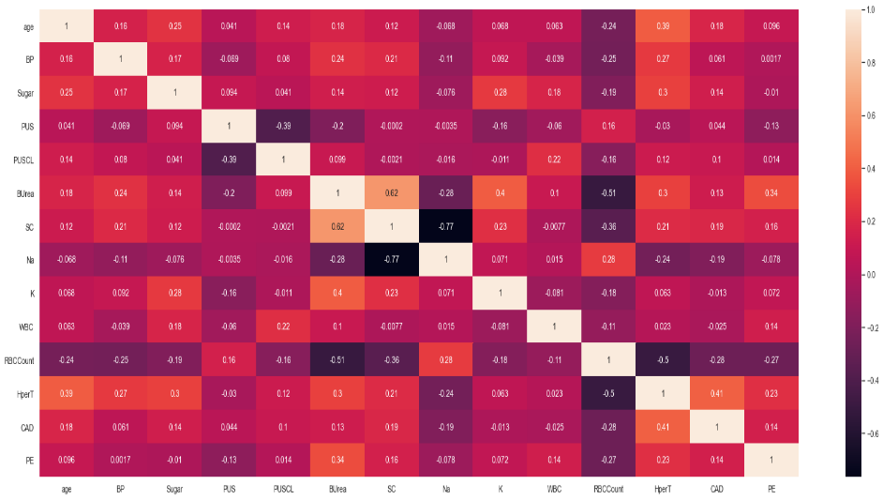
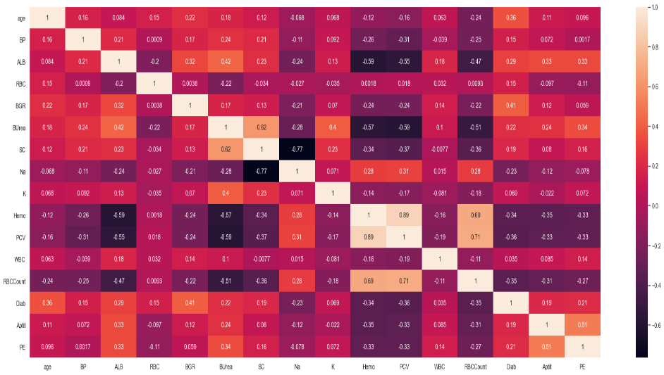
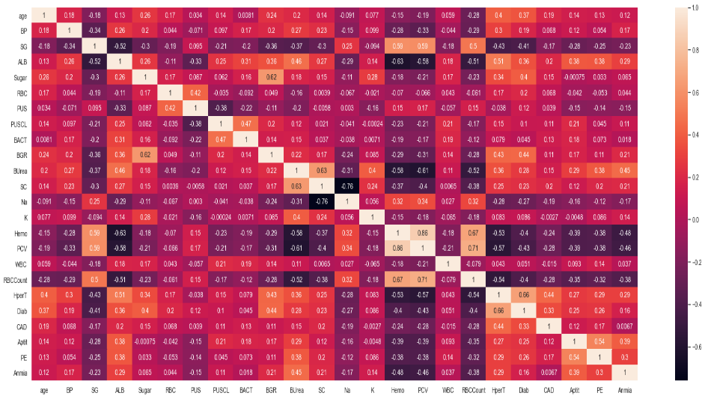
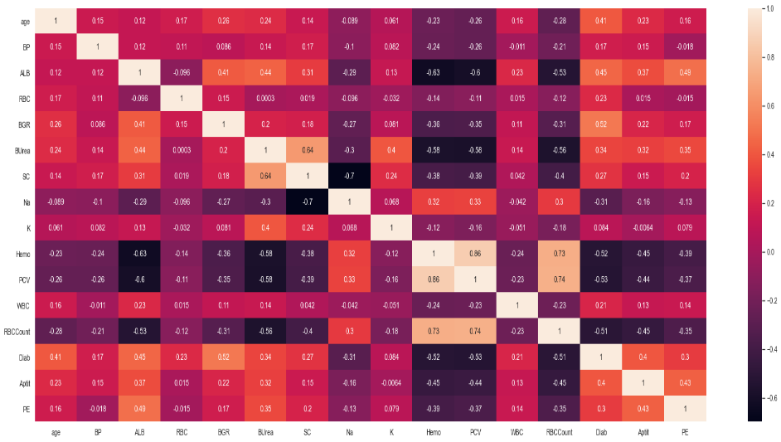
RESULTS:
Heat Maps of Correlation b/w Features:
Full Features
CFS
Wrapper
LASSO
SMOTE with Full Features
SMOTE with LASSO

Slide 22
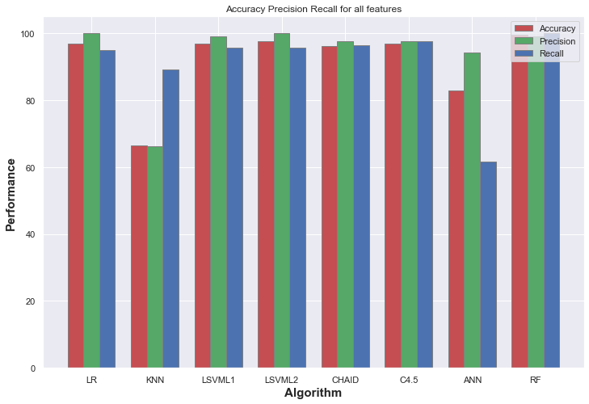
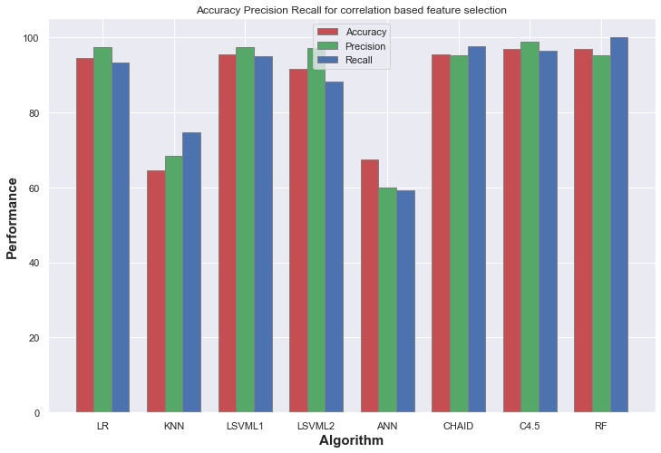
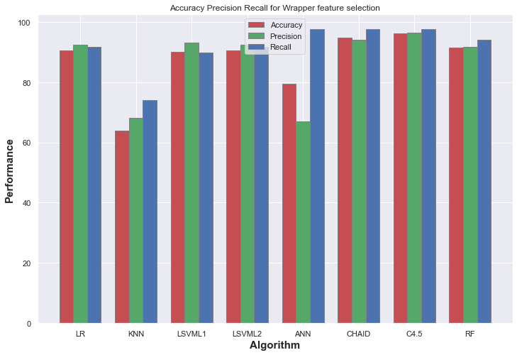
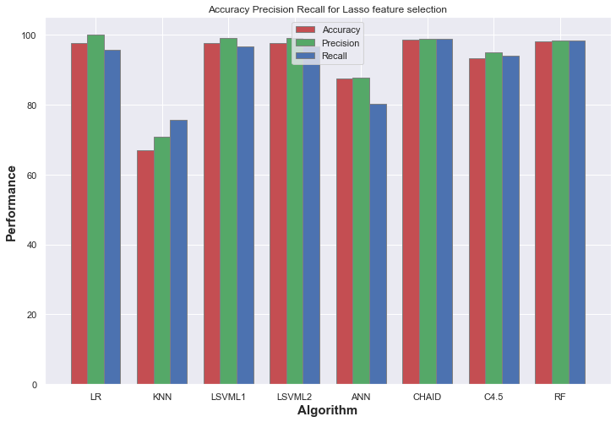
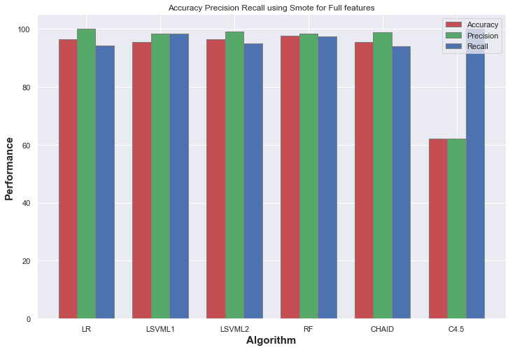
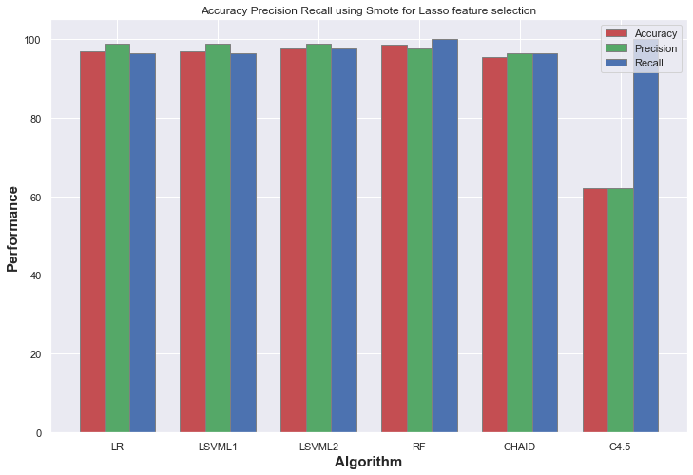
Accuracy, Precision, Recall:

Slide 23
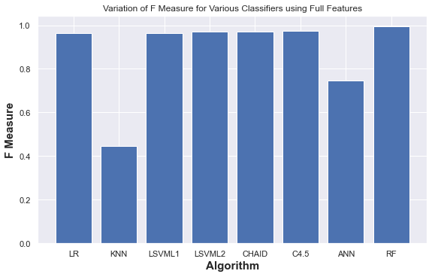
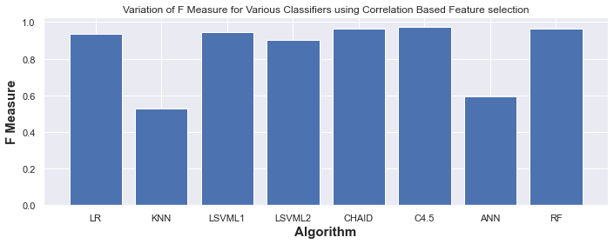
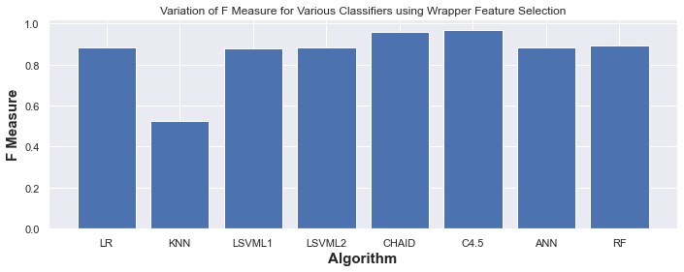
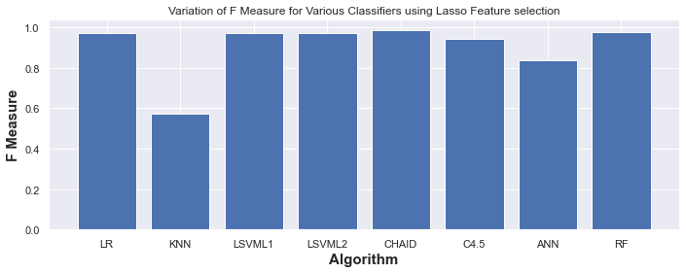
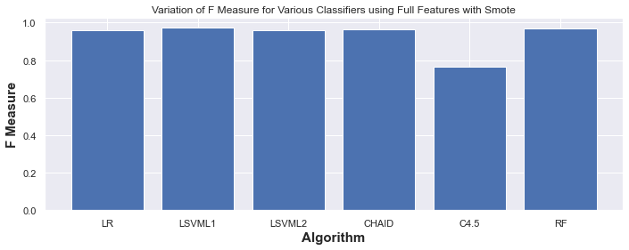
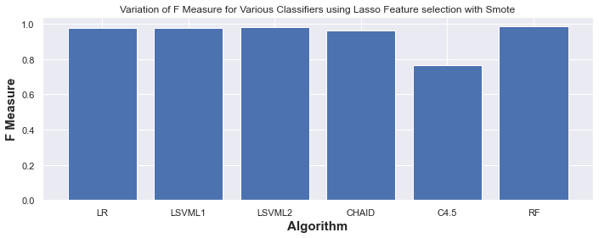
F-Measure:

Slide 24
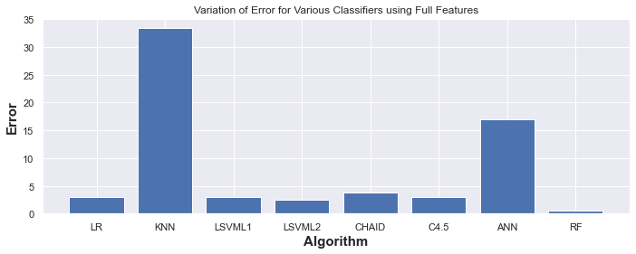
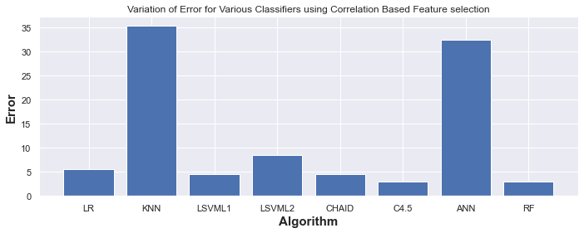
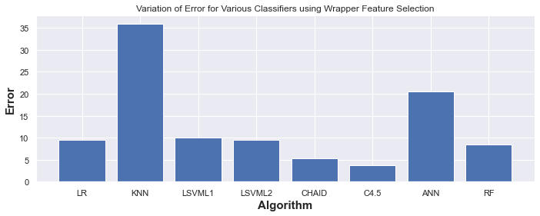
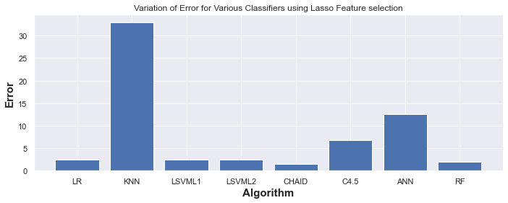
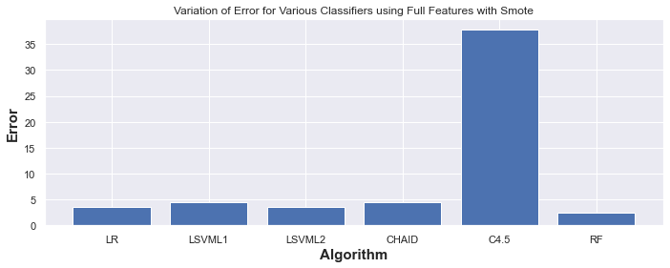
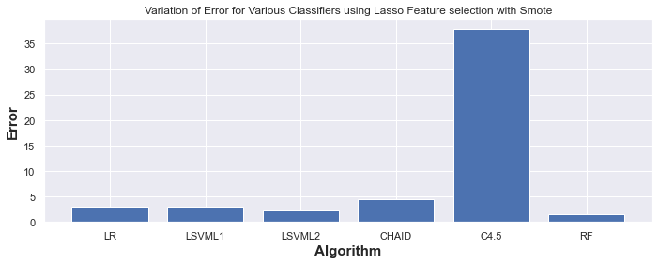
Classification Error:

Slide 25
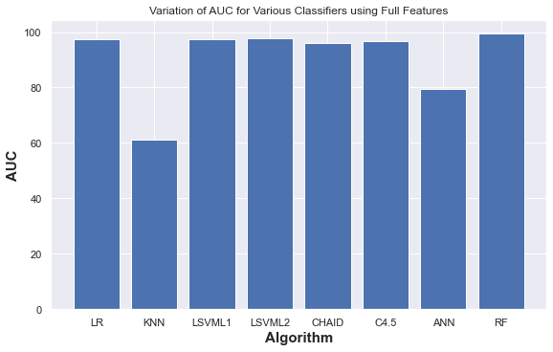
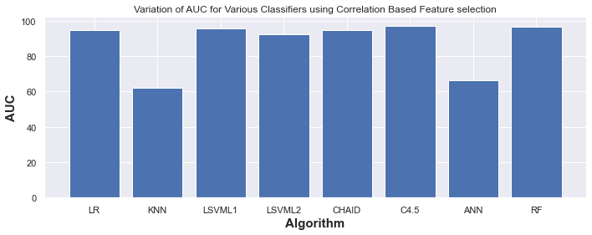
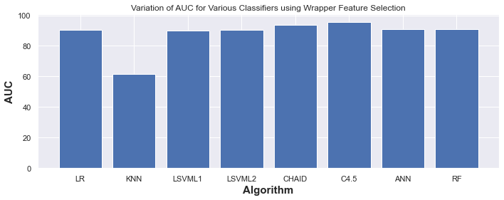
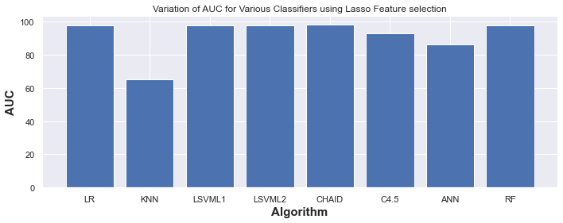
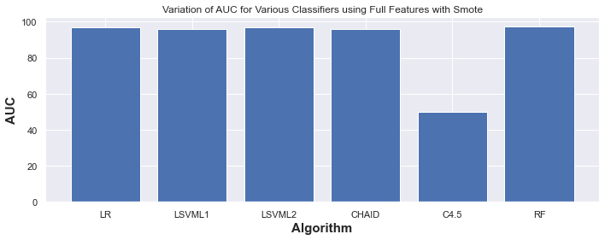
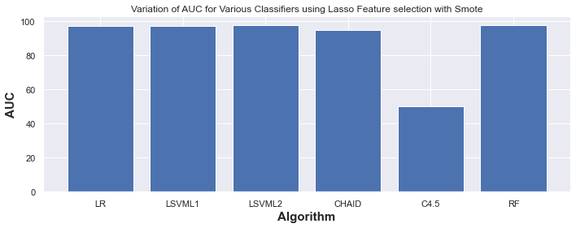
AUC or ROC:

Slide 26
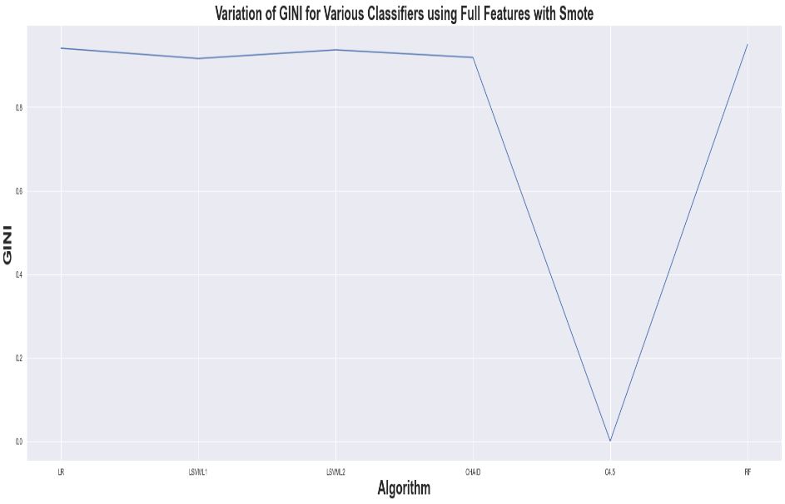
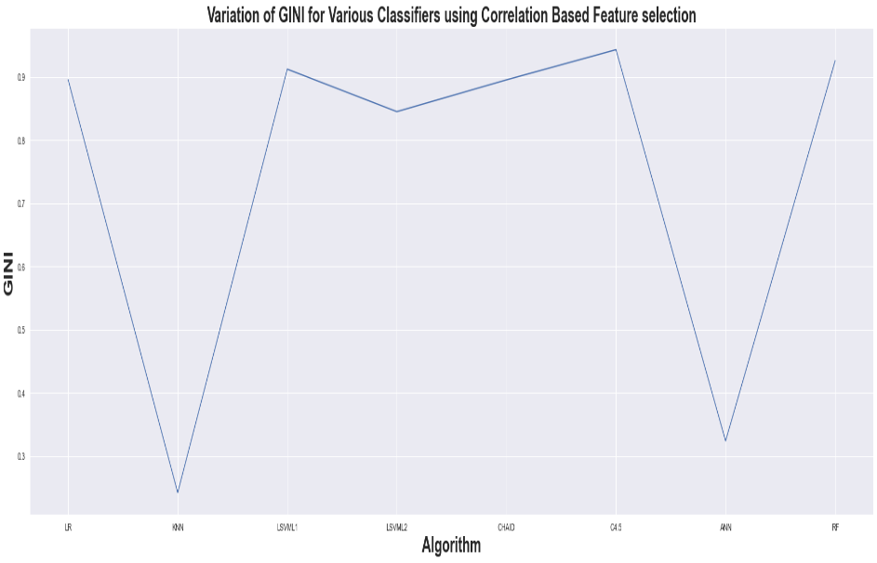
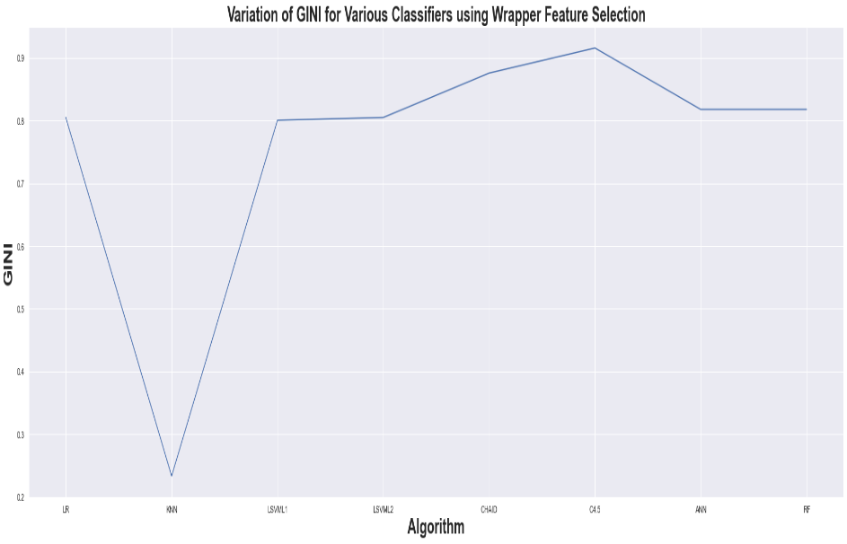
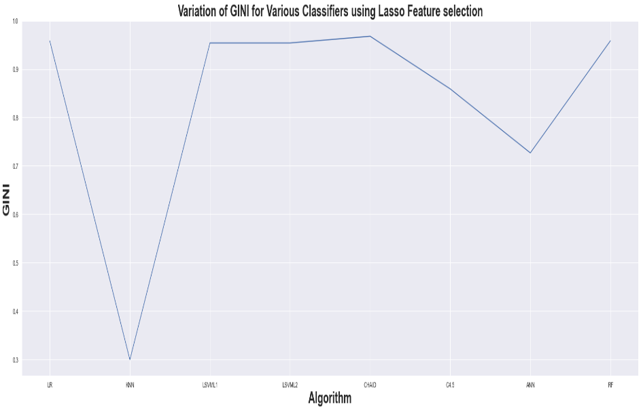
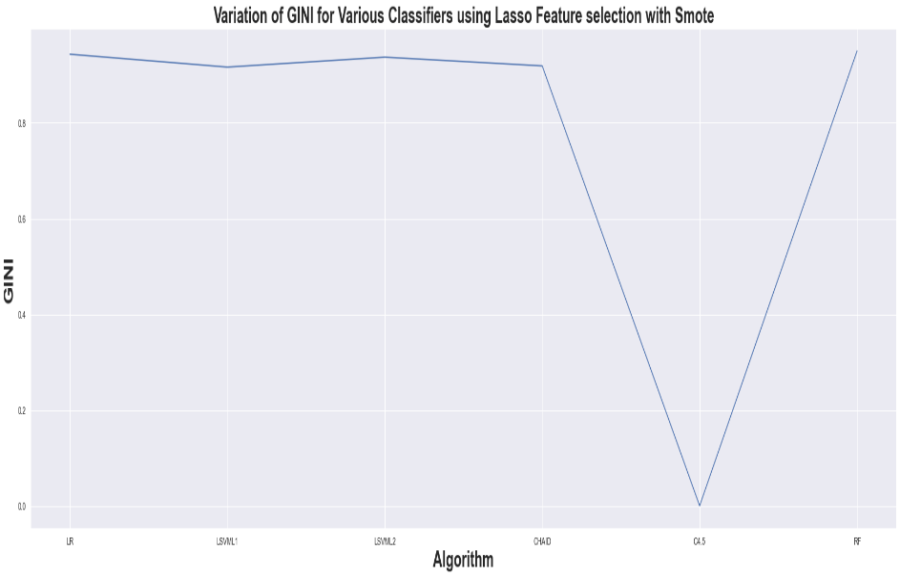
GINI INDEX:

Slide 27
Accuracy Table of Classifiers:
Classifiers | Full Features | CFS | Wrapper | LASSO | SMOTE with Full Features | SMOTE with LASSO
Logistic Regression | 97.0 % | 94.5 % | 90.5 % | 97.5 % | 96.5 % | 96.97 %
LSVM L1 | 97.0 % | 95.5 % | 90.0 % | 97.5 % | 95.5 % | 96.97 %
LSVM L2 | 97.5 % | 91.5 % | 90.5 % | 97.5 % | 96.5 % | 97.73 %
CHAID | 96.22 % | 95.45 % | 94.67% | 98.49 % | 95.46 % | 95.46 %
C 4.5 | 96.97 % | 96.97 % | 96.22 % | 93.19 % | 62.13 % | 62.13 %
Random Forest | 99.5 % | 97.0 % | 91.5 % | 98.0 % | 97.5 % | 98.49 %

Slide 28
CONCLUSION:
In this paper, we primarily focus on CKD prediction using ML classifier algorithms. We used ML classifier algorithms such as LR, KNN, LSVM with penalty L1 & penalty L2, RF, CHAID, C 4.5, and ANN. Results for all FS methods, full feature, Correlation based, Wrapper, and LASSO FS are computed for each classifier.
In terms of accuracy and other metrics, LR, LSVM L1, LSVM L2, CHAID, C 4.5, and RF perform better than Full Features and LASSO Feature Selection.
The results of the above-mentioned classifiers and FS methods are computed using SMOTE. Because the KNN and ANN algorithms did not produce satisfactory results, we did not use them for SMOTE.
With LASSO Feature Selection and SMOTE, Random Forest performs best with an accuracy of 98.49 percent, followed by LSVM penalty L2 with an accuracy of 97.73 percent.
As a result of the findings, it was determined that Random Forest in case of LASSO Feature Selection with SMOTE provides more accurate results when predicting CKD.

Slide 29
MERITS :
ML classifiers are commonly used for prediction. We used several FS methods to improve accuracy.
Not every algorithm performs well with a well-balanced data set. As a result, we used SMOTE to balance the dataset.
DEMERITS:
In general, ANN and KNN are better performing classifiers, but their performance on our data set was poor.
FUTURE PLANS :
Because our data set has an average number of instances, we oversampled it using SMOTE.
In the future, considering a data set with a large number of instances, under sampling is possible and can be done using the same procedure.

Slide 30
REFERENCES
Pankaj Chittora, Sandeep Chaurasia, Prasun Chakrabarti & others, (2021) “Prediction of Chronic Kidney Disease - A Machine Learning Perspective”, IEEE Access.2021.3053763.
J. Qin, L. Chen, Y. Liu, C. Liu, C. Feng, and B. Chen, ‘‘A machine learning methodology for diagnosing chronic kidney disease,’’ IEEE Access, vol. 8, pp. 20991–21002, 2020.
G. R. Vasquez-Morales, S. M. Martinez-Monterrubio, P. Moreno-Ger, and J. A. Recio-Garcia, ‘‘Explainable prediction of chronic renal disease in the colombian population using neural networks and case-based reasoning,’’ IEEE Access, vol. 7, pp. 152900–152910, 2019.
Y. Amirgaliyev, S. Shamiluulu, and A. Serek, ‘‘Analysis of chronic kidney disease dataset by applying machine learning methods,’’ in Proc. IEEE 12th Int. Conf. Appl. Inf. Commun. Technol. (AICT), Oct. 2018, pp. 1–4.
W. Gunarathne, K. D. M Perera, and K. A. D. C. P Kahandawaarachchi, ‘‘Performance evaluation on machine learning classification techniques for disease classification and forecasting through data analytics for chronic kidney disease (CKD),’’ in Proc. IEEE 17th Int. Conf. Bioinf. Bioeng. (BIBE), Oct. 2017, pp. 291–296.
K. R. A. Padmanaban and G. Parthiban, ‘‘Applying machine learning techniques for predicting the risk of chronic kidney disease,’’ Indian J. Sci. Technol., vol. 9, no. 29, Aug. 2016.
L. Kilvia De Almeida, L. Lessa, A. Peixoto, R. Gomes, and J. Celestino, ‘‘Kidney failure detection using machine learning techniques,’’ in Proc. 8th Int. Workshop ADVANCEs ICT Infrastructures Services, 2020, pp. 1–8.
M. Almasoud and T. E. Ward, ‘‘Detection of chronic kidney disease using machine learning algorithms with least number of predictors,’’ Int. J. Adv. Comput. Sci. Appl., vol. 10, no. 8, pp. 89–96, 2019.
S. Shankar, S. Verma, S. Elavarthy, T. Kiran, and P. Ghuli, ‘‘Analysis and prediction of chronic kidney disease,’’ Int. Res. J. Eng. Technol., vol. 7, no. 5, May 2020, pp. 4536–4541.

Slide 31


